Slide 1
虛擬化技術 Virtualization and Virtual Machines
Intel Virtualization Technology

Slide 2
Agenda
CPU Virtualization: Intel VT-x
Memory Virtualization: Extended Page Tables (EPT)
IO Virtualization: Intel VT-d

Slide 3
CPU Virtualization
Intel VT-x

Slide 4
CPU Architecture
What is trap ?
When CPU is running in user mode, some internal or external events, which need to be handled in kernel mode, take place.
Then CPU will jump to hardware exception handler vector, and execute system operations in kernel mode.
Trap types :
System Call
Invoked by application in user mode.
For example, application ask OS for system IO.
Hardware Interrupts
Invoked by some hardware events in any mode.
For example, hardware clock timer trigger event.
Exception
Invoked when unexpected error or system malfunction occur.
For example, execute privilege instructions in user mode.

Slide 5
Trap and Emulate Model
If we want CPU virtualization to be efficient, how should we implement the VMM ?
We should make guest binaries run on CPU as fast as possible.
Theoretically speaking, if we can run all guest binaries natively, there will NO overhead at all.
But we cannot let guest OS handle everything, VMM should be able to control all hardware resources.
Solution :
Ring Compression
Shift traditional OS from kernel mode(Ring 0) to user mode(Ring 1), and run VMM in kernel mode.
Then VMM will be able to intercept all trapping event.

Slide 6
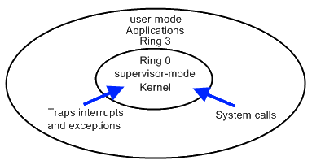
Trap and Emulate Model
VMM virtualization paradigm (trap and emulate) :
Let normal instructions of guest OS run directly on processor in user mode.
When executing privileged instructions, hardware will make processor trap into the VMM.
The VMM emulates the effect of the privileged instructions for the guest OS and return to guest.

Slide 7
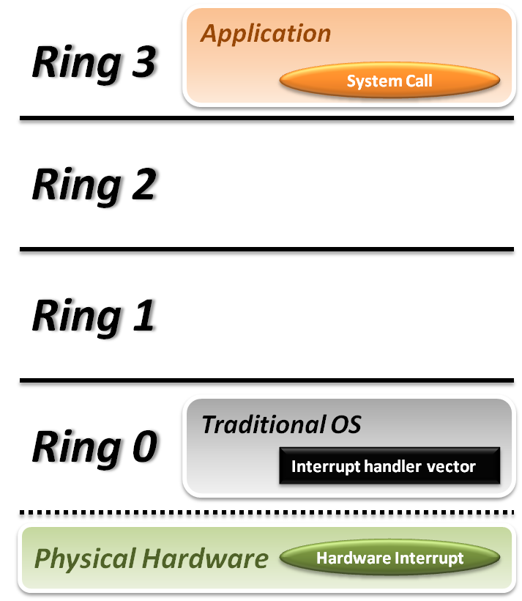


Trap and Emulate Model
Traditional OS :
When application invoke a system call :
CPU will trap to interrupt handler vector in OS.
CPU will switch to kernel mode (Ring 0) and execute OS instructions.
When hardware event :
Hardware will interrupt CPU execution, and jump to interrupt handler in OS.

Slide 8
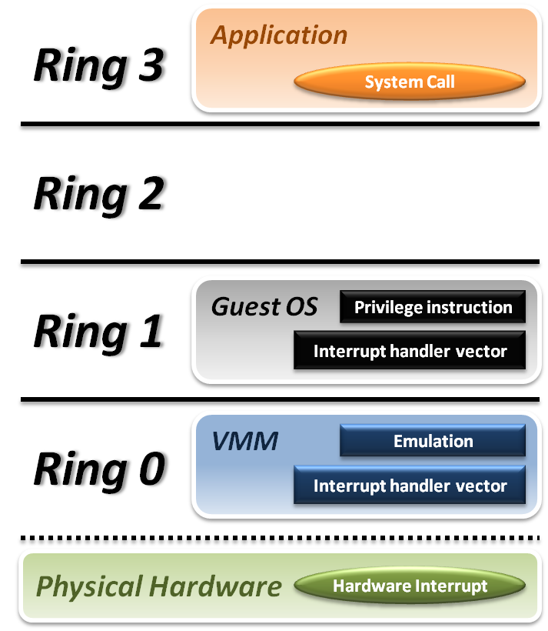






Trap and Emulate Model
VMM and Guest OS :
System Call
CPU will trap to interrupt handler vector of VMM.
VMM jump back into guest OS.
Hardware Interrupt
Hardware make CPU trap to interrupt handler of VMM.
VMM jump to corresponding interrupt handler of guest OS.
Privilege Instruction
Running privilege instructions in guest OS will be trapped to VMM for instruction emulation.
After emulation, VMM jump back to guest OS.

Slide 9
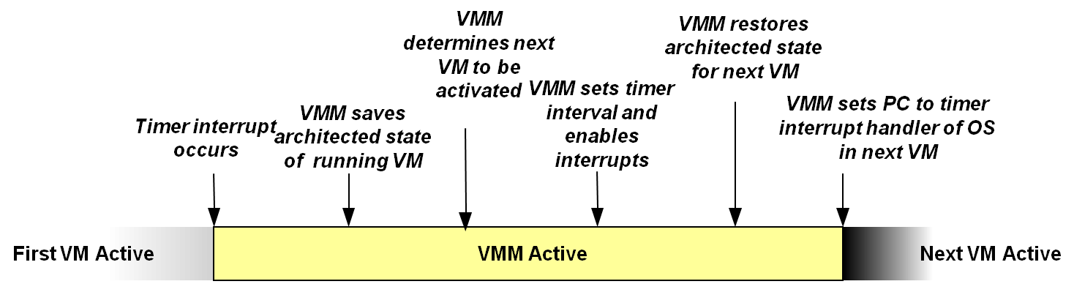
Context Switch
Steps of VMM switch different virtual machines :
Timer Interrupt in running VM.
Context switch to VMM.
VMM saves state of running VM.
VMM determines next VM to execute.
VMM sets timer interrupt.
VMM restores state of next VM.
VMM sets PC to timer interrupt handler of next VM.
Next VM active.

Slide 10
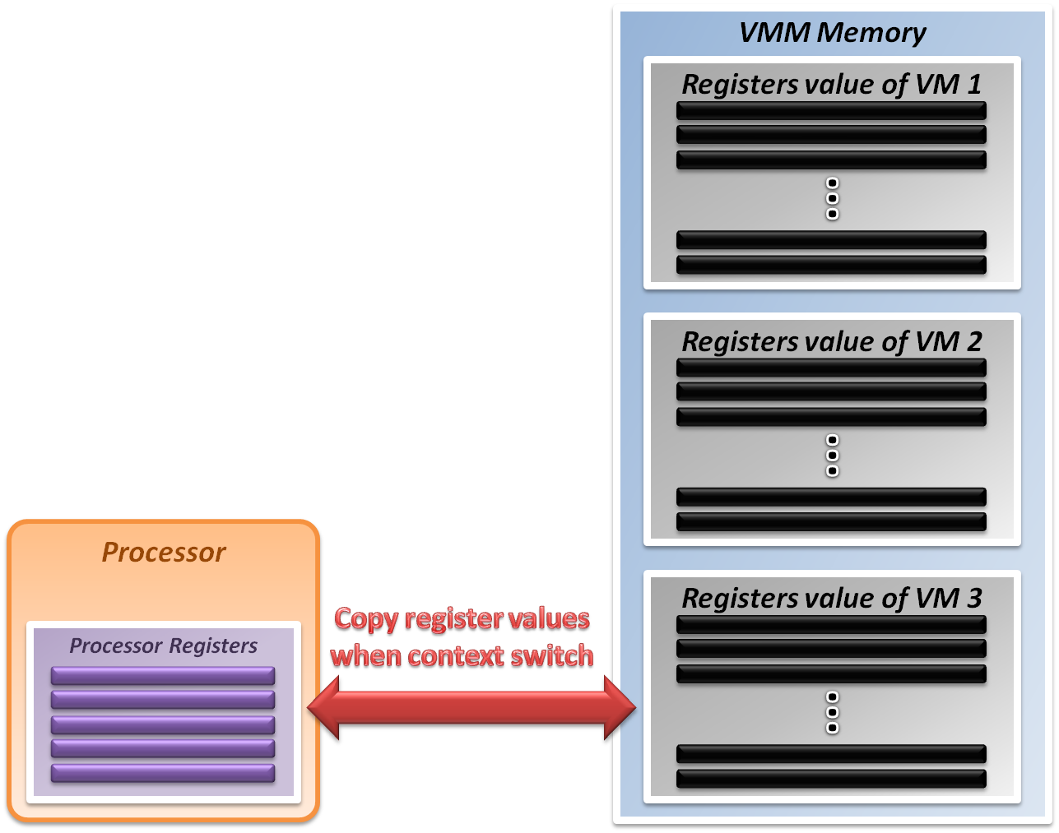
System State Management
Virtualizing system state :
VMM will hold the system states of all virtual machines in memory.
When VMM context switch from one virtual machine to another
Write the register values back to memory
Copy the register values of next guest OS to CPU registers.

Slide 11
Virtualization Theorem
Subset theorem :
For any conventional third-generation computer, a VMM may be constructed if the set of sensitive instructions for that computer is a subset of the set of privileged instructions.
Recursive Emulation :
A conventional third-generation computer is recursively virtualizable if
It is virtualizable
VMM without any timing dependencies can be constructed for it.
Under this theorem, x86 architecture cannot be virtualized directly. Other techniques are needed.

Slide 12
Virtualization Techniques
How to virtualize unvirtualizable hardware :
Para-virtualization
Modify guest OS to skip the critical instructions.
Implement some hyper-calls to trap guest OS to VMM.
Binary translation
Use emulation technique to make hardware virtualizable.
Skip the critical instructions by means of these translations.
Hardware assistance
Modify or enhance ISA of hardware to provide virtualizable architecture.
Reduce the complexity of VMM implementation.

Slide 13
Some Difficulties
Difficulties of binary translation :
Self-modifying code
If guest OS will modify its own binary code in runtime, binary translation need to flush the responding code cache and retranslate the code block.
Self-reference code
If guest code need to reference(read) its own binary code in runtime, VMM need to make it referring back to original guest binaries location.
Real-time system
For some timing critical guest OS, emulation environment will lose precise timing, and this problem cannot be perfectly solved yet.
Difficulty of para-virtualization :
Guest OS modification
User should at least has the source code of guest OS and modify its kernel; otherwise, para-virtualization cannot be used.

Slide 14
Hardware Solution
Why are there so many problems and difficulties ?
Critical instructions do not trap in user mode.
Even if we make those critical instructions trap, their semantic may also be changed; which is not acceptable.
In short, legacy processors did not design for virtualization purpose at the beginning.
If processor can be aware of the different behaviors between guest and host, the VMM design will be more efficient and simple.

Slide 15
Hardware Solution
Let’s go back to trap model :
Some trap types do not need the VMM involvement.
For example, all system calls invoked by application in guest OS should be caught by gust OS only. There is no need to trap to VMM and then forward it back to guest OS, which will introduce context switch overhead.
Some critical instructions should not be executed by guest OS.
Although we make those critical instructions trap to VMM, VMM cannot identify whether this trapping action is caused by the emulation purpose or the real OS execution exception.
Solution :
We need to redefine the semantic of some instructions.
We need to introduce new CPU control paradigm.

Slide 16
Intel VT-x
In order to straighten those problems out, Intel introduces one more operation mode of x86 architecture.
VMX Root Operation (Root Mode)
All instruction behaviors in this mode are no different to traditional ones.
All legacy software can run in this mode correctly.
VMM should run in this mode and control all system resources.
VMX Non-Root Operation (Non-Root Mode)
All sensitive instruction behaviors in this mode are redefined.
The sensitive instructions will trap to Root Mode.
Guest OS should run in this mode and be fully virtualized through typical “trap and emulation model”.

Slide 17
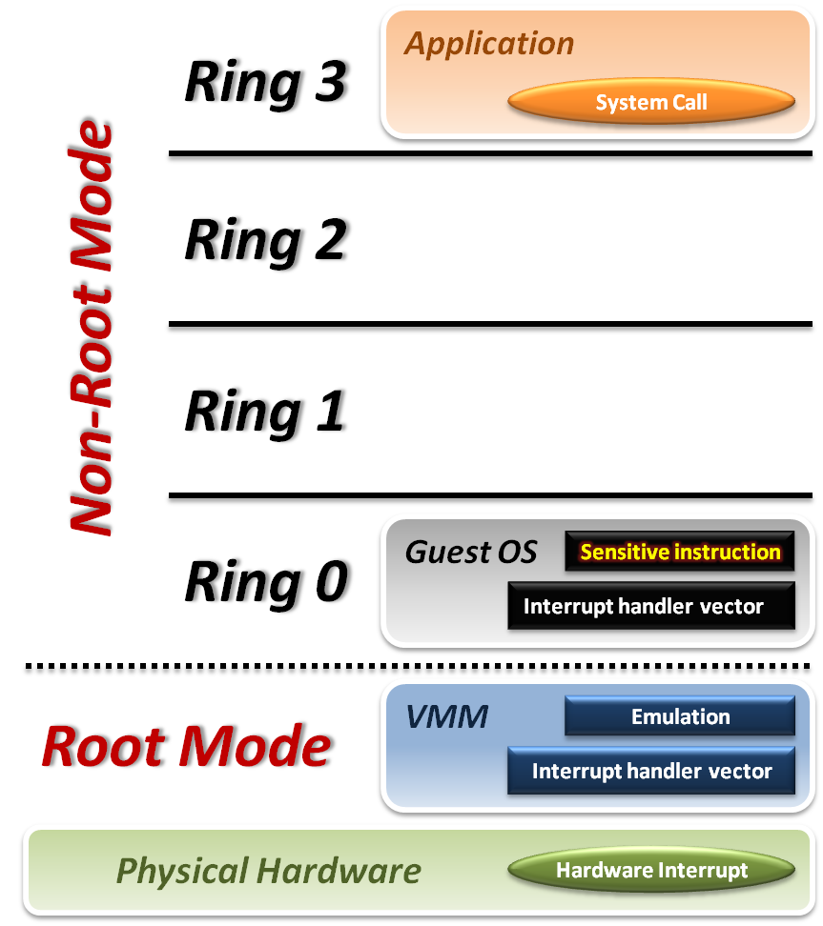





Intel VT-x
VMM with VT-x :
System Call
CPU will directly trap to interrupt handler vector of guest OS.
Hardware Interrupt
Still, hardware events need to be handled by VMM first.
Sensitive Instruction
Instead of trap all privilege instructions, running guest OS in Non-root mode will trap sensitive instruction only.

Slide 18
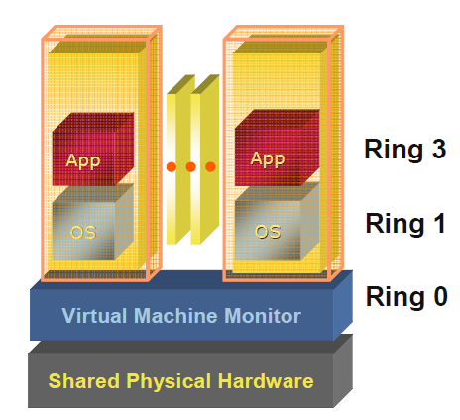
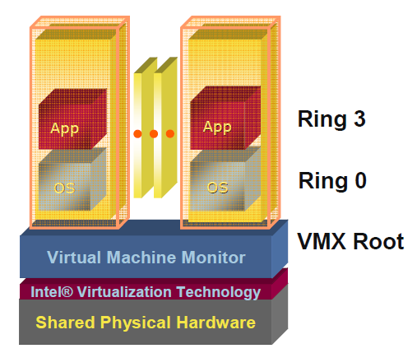
Pre & Post Intel VT-x
VMM de-privileges the guest OS into Ring 1, and takes up Ring 0
OS un-aware it is not running in traditional ring 0 privilege
Requires compute intensive SW translation to mitigate
VMM has its own privileged level
where it executes
No need to de-privilege the guest OS
OSes run directly on the hardware

Slide 19
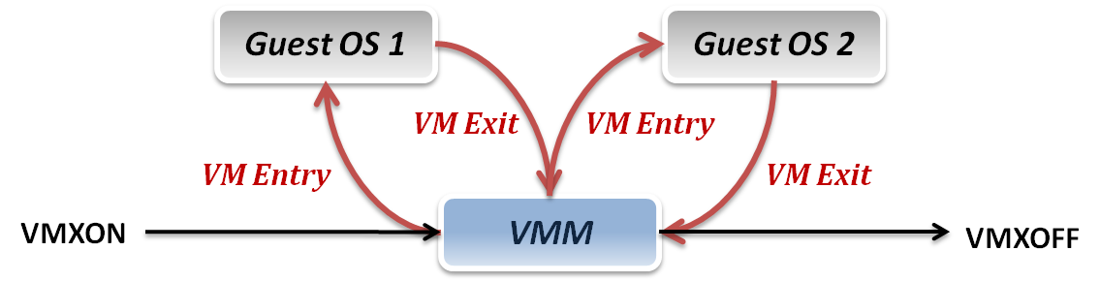
Context Switch
VMM switch different virtual machines with Intel VT-x :
VMXON/VMXOFF
These two instructions are used to turn on/off CPU Root Mode.
VM Entry
This is usually caused by the execution of VMLAUNCH/VMRESUME instructions, which will switch CPU mode from Root Mode to Non-Root Mode.
VM Exit
This may be caused by many reasons, such as hardware interrupts or sensitive instruction executions.
Switch CPU mode from Non-Root Mode to Root Mode.

Slide 20
System State Management
Intel introduces a more efficient hardware approach for register switching, VMCS (Virtual Machine Control Structure) :
State Area
Store host OS system state when VM-Entry.
Store guest OS system state when VM-Exit.
Control Area
Control instruction behaviors in Non-Root Mode.
Control VM-Entry and VM-Exit process.
Exit Information
Provide the VM-Exit reason and some hardware information.
Whenever VM Entry or VM Exit occur, CPU will automatically read or write corresponding information into VMCS.

Slide 21
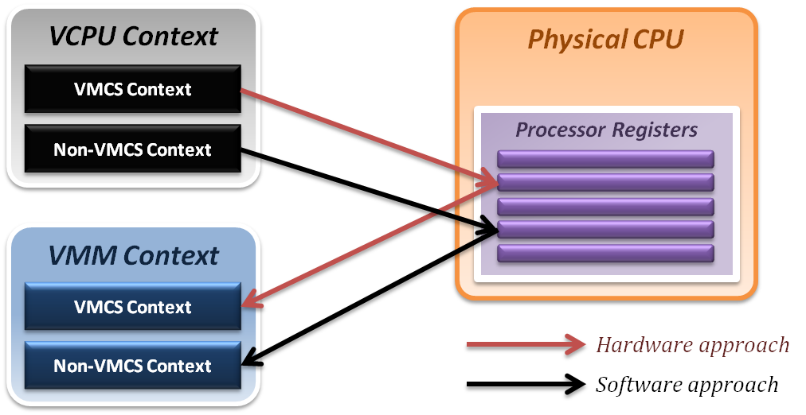
System State Management
Binding virtual machine to virtual CPU
VCPU (Virtual CPU) contains two parts
VMCS maintains virtual system states, which is approached by hardware.
Non-VMCS maintains other non-essential system information, which is approach by software.
VMM needs to handle Non-VMCS part.

Slide 22
Memory Virtualization
Extended Page Tables (EPT)

Slide 23
Hardware Solution
Difficulties of shadow page table technique :
Shadow page table implementation is extremely complex.
Page fault mechanism and synchronization issues are critical.
Host memory space overhead is considerable.
But why we need this technique to virtualize MMU ?
MMU do not first implemented for virtualization.
MMU is knowing nothing about two level page address translation.
Now, let us consider hardware solution.

Slide 24
Extended Page Table
Concept of Extended Page Table (EPT) :
Instead of walking along with only one page table hierarchy, EPT technique implement one more page table hierarchy.
One page table is maintained by guest OS, which is used to generate guest physical address.
The other page table is maintained by VMM, which is used to map guest physical address to host physical address.
For each memory access operation, EPT MMU will directly get guest physical address from guest page table, and then get host physical address by the VMM mapping table automatically.

Slide 25
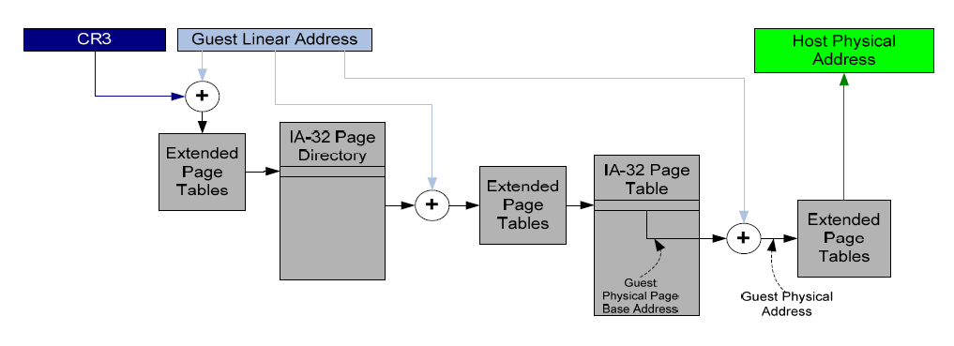
EPT Translation: Details
All guest-physical addresses go through extended page tables

Slide 26
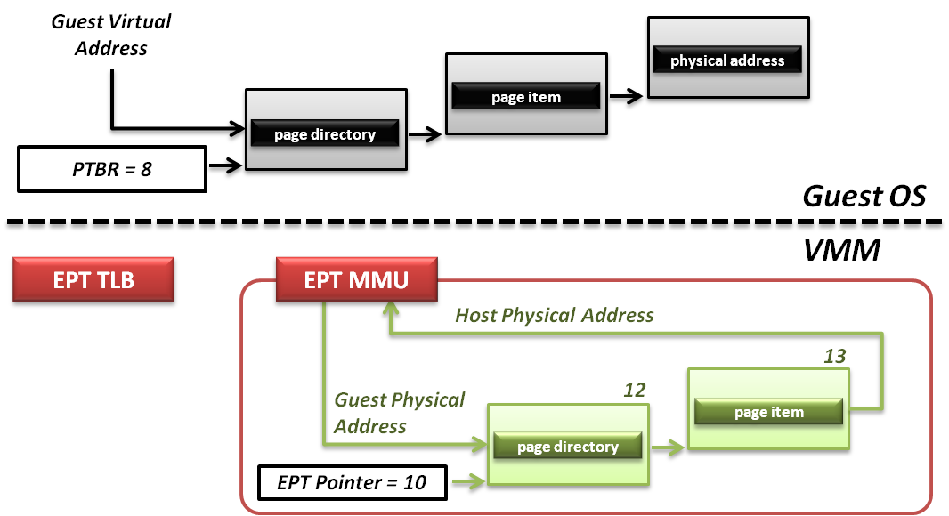
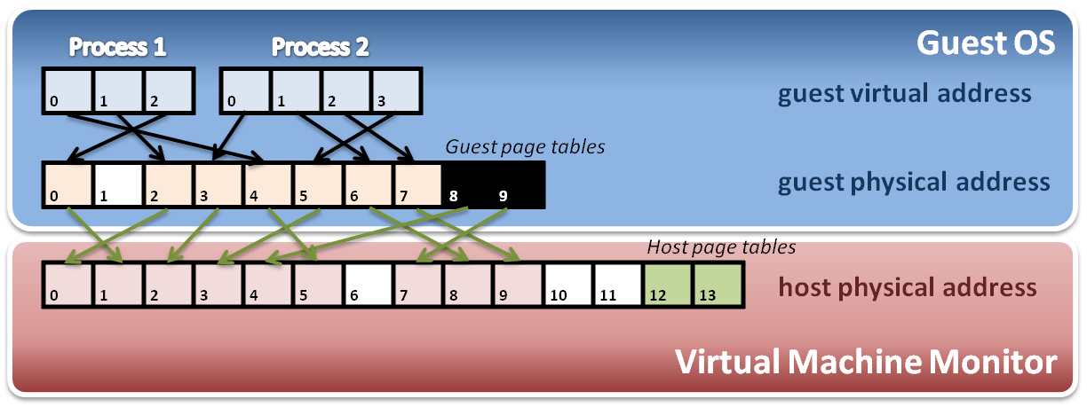
Memory Operation
6
8
9
7
8
4
Data

Slide 27
IO Virtualization
Intel VT-d

Slide 28
Hardware Solution
Difficulty :
Software cannot make data access directly from devices.
Intel hardware solutions :
Implement DMA remapping in hardware
Remap DMA operations automatically by hardware.
Intel VT-d

Slide 29

Options For I/O Virtualization
Monolithic Model
Service VM Model
Pass-through Model
Service VMs
Guest VMs
VM₀
VM_{n}
VM₀
VM_{n}
I/O Services
VM_{n}
Guest OS
and Apps
Guest OS
and Apps
Guest OS
and Apps
Guest OS
and Apps
VM₀
Hypervisor
Device Drivers
Guest OS
and Apps
Device Drivers
Device Drivers
I/O Services
Device Drivers
Hypervisor
Hypervisor
Shared Devices
Shared Devices
Assigned Devices
Pro: Higher Performance
Pro: I/O Device Sharing
Pro: VM Migration
Con: Larger Hypervisor
Pro: High Security
Pro: I/O Device Sharing
Pro: VM Migration
Con: Lower Performance
Pro: Highest Performance
Pro: Smaller Hypervisor
Pro: Device assisted sharing
Con: Migration Challenges
VT-d Goal: Support all Models

Slide 30
VT-d Overview
VT-d is platform infrastructure for I/O virtualization
Defines architecture for DMA remapping
Implemented as part of platform core logic
Will be supported broadly in Intel server and client chipsets
CPU
CPU
System Bus
North Bridge
DRAM
VT-d
Integrated
Devices
PCIe* Root Ports
PCI Express
South
Bridge
PCI, LPC,
Legacy devices, …

Slide 31
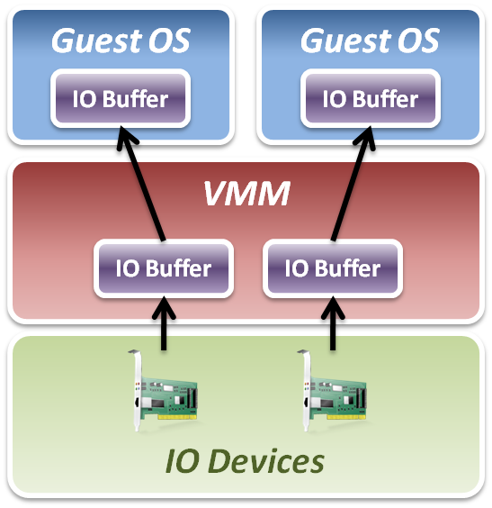
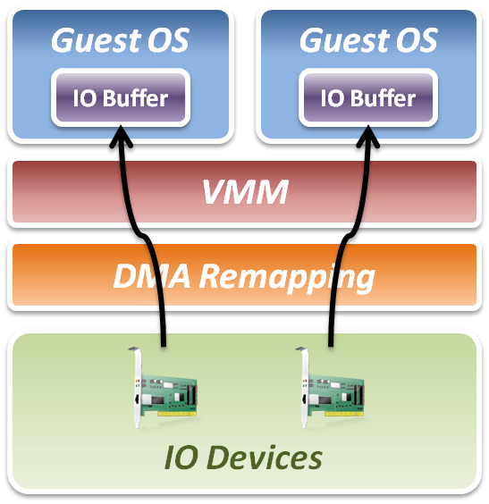
Intel VT-d
Add DMA remapping hardware component.
Software Approach
Hardware Approach

Slide 32
Remapping Benefits
Protection:
Enhance security and reliability through device isolation
End to end isolation from VM to devices
Performance:
Allows I/O devices to be directly assigned to specific virtual machines
Eliminate Bounce buffer conditions with 32-bit devices
Efficiency:
Interrupt isolation and load balancing
System scalability with extended xAPIC support
Core platform infrastructure for Single Root IOV

Slide 33
VT-d Architecture Detail
DMA Requests
Device ID
…
Dev 31, Func 7
Virtual Address
Length
Dev P, Func 2
Bus 255
Page
Frame
Fault Generation
Bus N
DMA Remapping
Engine
Bus 0
Dev P, Func 1
4KB Page
Tables
Dev 0, Func 0
Address Translation
Structures
Device
Assignment
Structures
Device D1
Translation Cache
Device D2
Address Translation
Structures
Context Cache
Memory Access with System Physical Address
Memory-resident Partitioning And
Translation Structures

Slide 34
VT-d: Hardware Page Walk
Requestor ID
DMA Virtual Address
15
8
7
3
2
0
63
57
56
48
47
39
38
30
29
21
20
12
11
0
Bus
Device
Func
000000b
000000000b
Level-4
table offset
Level-3 table offset
Level-2 table offset
Level-1 table offset
Page Offset
Base
Device Assignment Tables
Page
Level-4
Page Table
Level-3
Page Table
Level-2
Page Table
Example Device Assignment Table Entry specifying 4-level page table
Level-1
Page Table

Slide 35
VT-d: Translation Caching
Architecture supports caching of remapping structures
Context Cache: Caches frequently used device-assignment entries
IOTLB: Caches frequently used translations (results of page walk)
Non-leaf Cache: Caches frequently used page-directory entries
When updating VT-d translation structures, software enforces consistency of these caches
Architecture supports global, domain-selective, and page-range invalidations of these caches
Primary invalidation interface through MMIO registers for synchronous invalidations
Extended invalidation interface for queued invalidations

Slide 36
VT-x & VT-d Working Together
Virtual Machines
Virtual Machine Monitor (VMM)
Binary Translation
Paravirtualization
Page-table Shadowing
IO-Device Emulation
Interrupt Virtualization
DMA Remap
VT-x
VT-d
Logical Processors
I/O Devices
Physical Memory
Hardware Virtualization Mechanisms under VMM Control

Slide 37
Summary
CPU Virtualization
Trap and Emulate Model
Virtualization technique, VMX Root/Non-Root Operation, VMM and Guest OS, VMCS … etc.
Memory Virtualization: Extended Page Tables (EPT)
EPT implement one more page table hierarchy
MMU virtualize, EPT translation, Memory Operation,… etc.
IO Virtualization: Intel VT-d
Implement DMA remapping in hardware
Hardware Page Walk, Translation Caching

Slide 38
References
Paper:
Uhlig, Rich, et al. "Intel virtualization technology." Computer 38.5 (2005): 48-56.
Web resources:
Intel Virtualization Technology: Strategy and Evolution - Microsoft http://download.microsoft.com/download/5/b/9/5b97017b-e28a-4bae-ba48-174cf47d23cd/vir054_wh06.ppt
Intel® Virtualization Transforms IT http://www.intel.com/content/www/us/en/virtualization/intel-virtualization-transforms-it.html

